Slide 1

ENGLISH 7

Slide 2
Welcome to
our lesson today!
our lesson today!

Slide 3
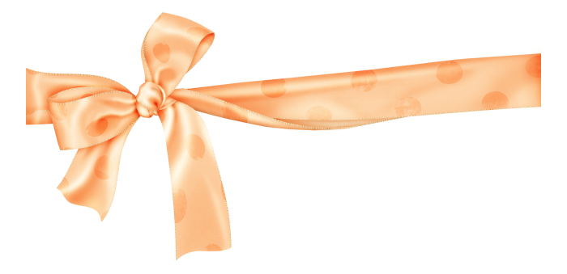
Matching

Slide 4

11
12
1
12
11
1
10
2
a
10
2
1
It’s four fifteen
4
9
3
9
3
8
4
8
4
7
6
5
7
5
b
It’s five twenty-five
6
12
c
11
12
1
11
1
It’s seven o’clock
10
2
10
2
2
5
9
3
9
3
8
4
d
8
4
7
5
It’s nine forty
7
6
5
6
e
12
It’s half past eight
11
12
11
1
1
10
2
10
2
3
9
3
9
3
6
8
4
f
It’s a quarter to two
8
4
7
5
7
6
5
6

Slide 5
Answer keys
11
12
1
12
11
1
10
2
a
10
2
1
It’s four fifteen
4
9
3
9
3
8
4
8
4
7
6
5
7
5
b
It’s five twenty-five
6
12
c
11
12
1
11
1
It’s seven o’clock
10
2
10
2
2
5
9
3
9
3
8
4
d
8
4
7
5
It’s nine forty
7
6
5
6
e
12
It’s half past eight
11
12
11
1
1
10
2
10
2
3
9
3
9
3
6
8
4
f
It’s a quarter to two
8
4
7
5
7
6
5
6

Slide 6

Unit 4: At school - Lesson 1 (A1, 2, 3)
A1. Listen and repeat
11
12
1
11
12
1
11
12
1
10
2
10
2
10
2
9
3
9
3
9
3
8
4
8
4
8
4
7
6
5
7
6
5
7
6
5
It’s four fifteen
It’s five twenty-five
It’s seven o’clock
It’s a quarter past four
It’s twenty-five past five
11
12
1
11
12
1
12
11
1
10
2
10
2
10
2
9
3
9
3
9
3
8
4
8
4
8
4
7
6
5
7
6
5
7
5
6
It’s eight thirty
It’s nine forty
It’s one forty-five
It’s a quarter to two
It’s half past eight
It’s twenty to ten

Slide 7
Unit 4: At school
Lesson 1 (A1, 2, 3)
- It is + hour + o’clock
- It is hour + minute
It is + minute + past / to + hour
- It is + a quarter + past / to + hour
- It is half past + hour
12
12
12
11
12
1
11
1
11
1
11
1
10
2
10
2
10
2
10
2
9
3
9
3
9
3
9
3
8
4
8
4
8
4
8
4
7
5
7
5
7
5
7
6
5
6
6
6

Slide 8
Unit 4: At school
Lesson 1 (A1, 2, 3)
- It is + hour + o’clock
- It is hour + minute
It is + minute + past / to + hour
- It is + a quarter + past / to + hour
- It is half past + hour
- What time is it?
11
12
1
10
2
- It is eight o’clock.
9
3
8
4
7
6
5

Slide 9
Unit 4: At school
Lesson 1 (A1, 2, 3)
- It is + hour + o’clock
- It is hour + minute
It is + minute + past / to + hour
- It is + a quarter + past / to + hour
- It is half past + hour
- What time is it?
11
12
1
10
2
- It is a quarter past seven.
9
3
- It is seven fifteen.
8
4
7
6
5

Slide 10
Unit 4: At school
Lesson 1 (A1, 2, 3)
- It is + hour + o’clock
- It is hour + minute
It is + minute + past / to + hour
- It is + a quarter + past / to + hour
- It is half past + hour
- What time is it?
11
12
1
10
2
- It is twenty past six.
9
3
- It is six twenty.
8
4
7
6
5

Slide 11
Unit 4: At school
Lesson 1 (A1, 2, 3)
- It is + hour + o’clock
- It is hour + minute
It is + minute + past / to + hour
- It is + a quarter + past / to + hour
- It is half past + hour
- What time is it?
11
12
1
10
2
9
3
- It is half past nine.
- It is nine thirty.
8
4
7
6
5

Slide 12
Unit 4: At school - Lesson 1 (A1, 2, 3)
A2: Answer about you.
Survey
Name | Getup | Classes start | Classes finish | Have lunch | Go to bed
Nam | 6.00 | 7.00 | 11.15 | 12.00 | 10pm
Hoa
A - What time do you get up?
- I get up at ……….
B - What time do classes start?
- They start at …….
C - What time do they finish?
- They finish at ……
D - What time do you have lunch?
- I have lunch at …
E - What time do you go to bed?
- I go to bed at……

Slide 13
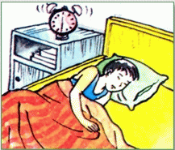
Unit 4: At school
Lesson 1 (A1, 2, 3)
Talk about your friend.
Example:
Nam gets up at 6.00. His classes start at 7.00 and finish at 11.15. He has lunch at 12.00. He goes to bed at 10pm.

Slide 14
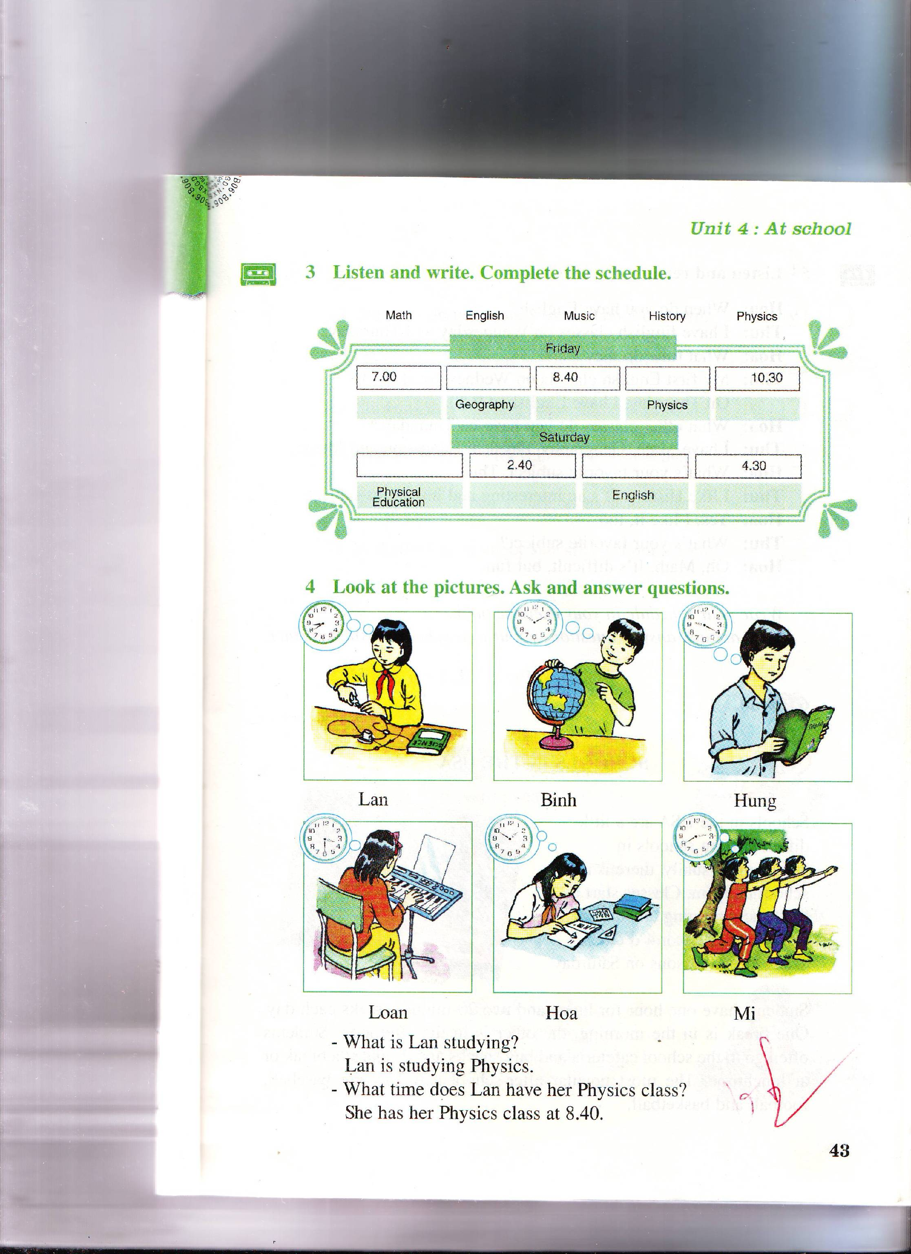
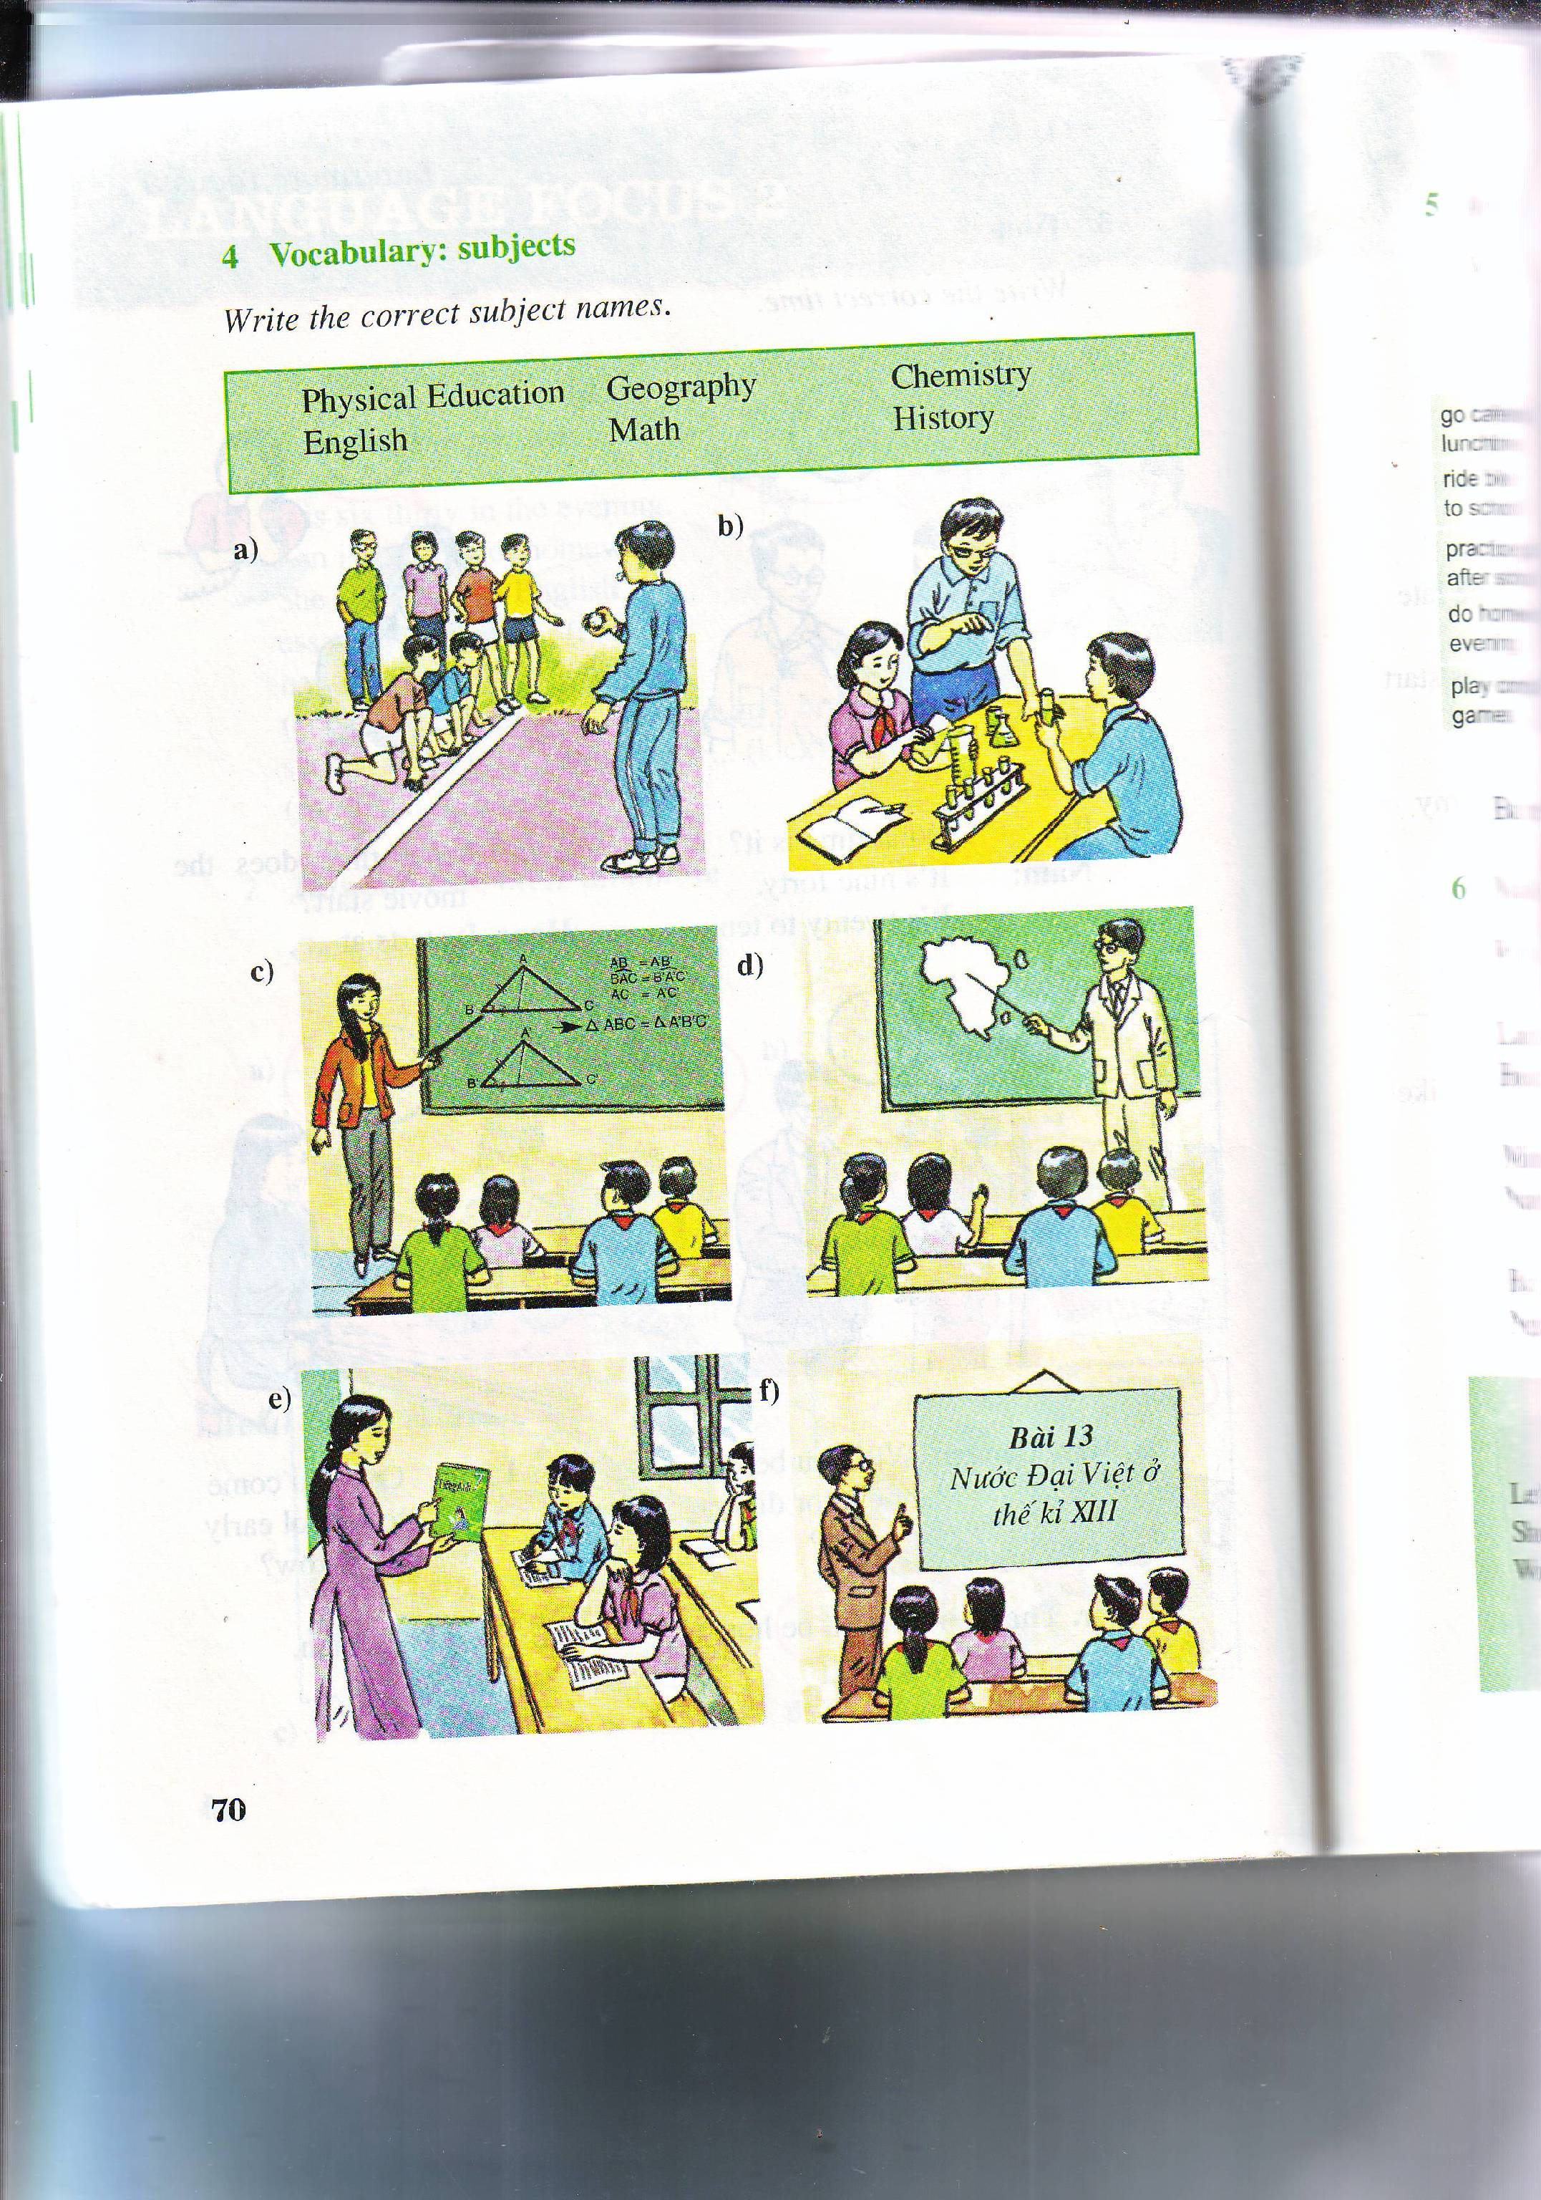
Unit 4: At school - Lesson 1 (A1, 2, 3)
A3. Listen and write. Complete the schedule.
Vocabulary
Physics: /ˈfɪ.zɪks/
Môn Vật lý
Physical education:
/ˌfɪz.ɪ.kəl ed.jʊˈkeɪ.ʃən/
Môn Thể dục

Slide 15
Unit 4: At school - Lesson 1 (A1, 2, 3)
A3. Listen and write. Complete the schedule.
Possible answers:
Math
Literature
Physical education
Subjects
Physics
English
History
Geography
Music

Slide 16
Unit 4: At school - Lesson 1 (A1, 2, 3)
A3. Listen and write. Complete the schedule.
Music
History
Math
Physics
Geography
Physical Education

Slide 17
Unit 4: At school - Lesson 1 (A1, 2, 3)
A3. Listen and write. Complete the schedule.
Friday
7.00 |  | 8.40 |  | 10.30
 | Geography |  | Physics
Saturday
 | 2.40 |  | 4.30
Physical Education |  | English

Slide 18
Unit 4: At school - Lesson 1 (A1, 2, 3)
A3. Listen and write. Complete the schedule.
Friday
7.00 |  | 8.40 |  | 10.30
 | Geography |  | Physics
7.50
9.40
English
Music
History
Saturday
 | 2.40 |  | 4.30
Physical Education |  | English
1.00
3.40
Math
Physics

Slide 19

Unit 4: At school - Lesson 1 (A1, 2, 3)
Exercises:
What time is it? Choose the right answer.
1.
A. It’s half past eleven
B. It’s eleven o’clock.
B. It’s eleven o’clock.
C. It’s twelve o’clock.

Slide 20

Unit 4: At school - Lesson 1 (A1, 2, 3)
Exercises:
What time is it? Choose the right answer.
2.
A. It’s a quarter past eleven
A. It’s a quarter past eleven.
B. It’s half past eleven .
C. It’s a quarter to eleven.

Slide 21
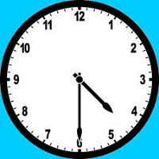
Unit 4: At school - Lesson 1 (A1, 2, 3)
Exercises:
What time is it? Choose the right answer.
3.
A. It’s half past two
B. It’s half past three .
C. It’s half past four.
C. It’s half past four.

Slide 22
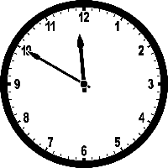
Unit 4: At school - Lesson 1 (A1, 2, 3)
Exercises:
What time is it? Choose the right answer.
4.
A. It’s ten past eleven
B. It’s ten to twelve .
B. It’s ten to twelve.
C. It’s ten past twelve.

Slide 23
Unit 4: At school
Lesson 1: Section (A1, 2, 3)
Homework
- Learn by heart how to tell the time
- Prepare Unit 1 (cont): A4.5
- The end -

Slide 24

Thanks for your attention!
Good bye!
&
See You later!

